Slide 1

⌚ BellaBeat Smart Wellness Device Analysis
Strategic Health Insights & Consumer Behaviour Trends for Global Market Scaling
Presented By: Pritesh Das, Junior Data Analyst, Marketing Analytics Team, Bellabeat

Slide 2
🎯 Business Task and Strategic Objectives
Core Mandate: Analyze public, non-Bellabeat smart wearable fitness data to uncover distinct consumer behavioral trends across physical activity, sleep cycles, and metabolic energy dynamics.
Strategic Goal: Translate data-driven insights into high-level marketing and product development recommendations to guide Bellabeat’s global expansion.
Leadership Objective: Provide co-founder and Chief Creative Officer Urška Sršen with actionable intelligence to optimize user engagement, refine digital campaigns, and scale up premium ecosystem monetization.

Slide 3
🗂️ Data Architecture and Analytical Scope
Primary Dataset: Fitbit Fitness Tracker Data (CC0 Public Domain via Mobius on Kaggle) tracking an active consumer cohort over a 31-day monitoring window.
Relational Input Tables: Granular data processed using SQL Server Management Studio (SSMS), including dailyActivity_merged.csv, sleepDay_merged.csv, hourlySteps_merged.csv, hourlyIntensities_merged.csv, hourlyCalories_merged.csv and minuteMETsNarrow_merged.csv tables.
Data Constraints & Mitigation:
Limitation: Compact sample size (33 unique user IDs) and lack of direct demographic markers (age, gender, location).
Mitigation: Heavily aggregated individual transactional records into group-level metrics, focusing on robust macro-level trends and weekday variations to eliminate statistical skew.

Slide 4
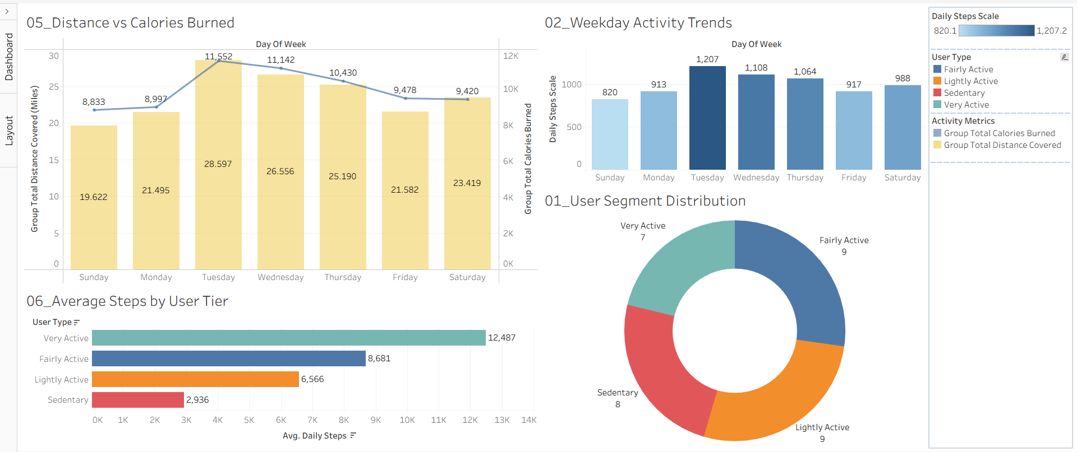
📊 Activity Profiling and Weekday Engagement Metrics

Slide 5
Activity and Engagement Trends
User Segment Distribution: The consumer landscape is highly diverse, tracking 8 Sedentary, 9 Lightly Active, 9 Fairly Active, and 7 Very Active users.
The Addressable Market: Lower-tier users (Sedentary and Lightly Active) comprise 51.5% of the tracked population, defining a massive customer acquisition opportunity.
The Performance Chasm: A severe behavioral gap exists between lifestyle groups; Very Active users average an exceptional 12,487 steps per day, while Sedentary users average a minimal 2,936 steps.
Weekly Workflow Fluctuations: Physical movement is highly non-uniform. Group activity sharply peaks mid-week on Tuesdays (index high: 1,207) and experiences a severe weekend slump, bottoming out on Sundays (index low: 820).

Slide 6
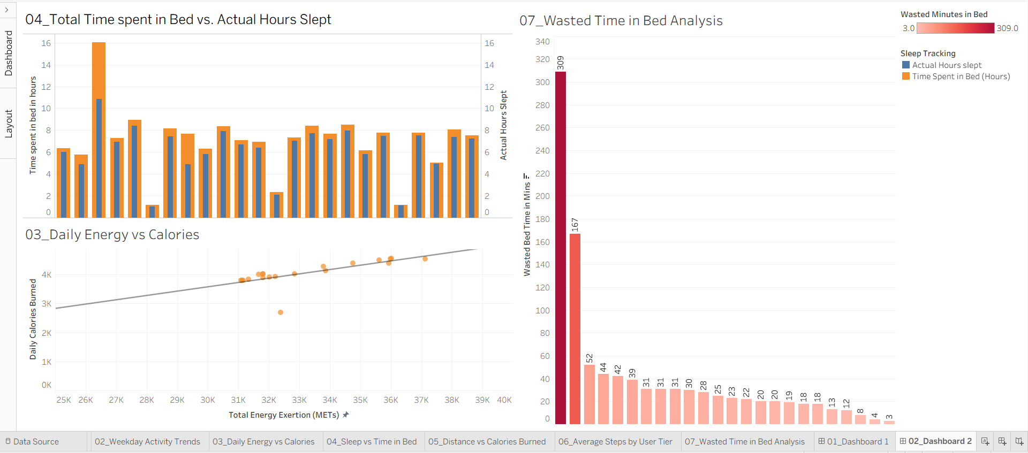
💤 Sleep Efficiency and Physiological Effort Dynamics

Slide 7
Sleep and Energy Dynamics
The Behavioral Sleep Gap: Widespread, systemic inefficiencies occur between sleep intent and physiological rest. While users consistently allocate a healthy 7 to 8 hours in bed, actual sleep durations frequently drop below 6 hours.
Wasted Time Outliers: Sleep vulnerability is highly individualized and skewed. A severe outlier spends an average of 309 minutes (over 5 hours) awake or restless in bed daily, while a secondary risk cluster loses 39 to 52 minutes nightly.
The Friday Calorie Divergence: On Fridays, collective distance traveled drops significantly to 21.58 miles, yet caloric burn remains highly resilient at 9,478 calories. This confirms stationary, high-exertion weekend gym training (weightlifting, pilates) that burns energy without forward mileage.
Algorithmic Verification: High-density scatter plots map a tight cluster between 30K and 38K METs, proving that daily calorie expenditure is reliably driven by verified physiological exertion.

Slide 8
💡 Key Insights
The Segment Opportunity: A major proportion (51.5%) of the tracked user base falls within the Sedentary and Lightly Active profiles, highlighting a massive market segment ripe for healthy lifestyle guidance.
The Performance Chasm: Metrics reveal a severe performance variance between groups. Very Active users average an exceptional 12,487 steps per day, while Sedentary users fall drastically behind at just 2,936 steps.
The Weekend Slump: Group activity tracking is not uniform. Physical movement peaks aggressively mid-week on Tuesdays (activity index: 1,207), but steadily drops as users lose weekly routine structure, bottoming out on Sundays (activity index: 820).
Systemic Sleep Inefficiency: Visual alignments prove a profound gap between behavioral intent and true physiological rest. Users regularly dedicate 7 to 9 optimal hours to being in bed while capturing under 6 hours of actual sleep.
The Restless Outlier: Pareto distribution analysis isolates severe individual sleep vulnerabilities, highlighting an extreme outlier losing an average of 309 minutes (over 5 hours) every single day lying awake inside the bedding frame.

Slide 9
🚀 Product Expansion and Engagement Roadmap Strategies
1. In-App "Sleep Hygiene Optimization" Module (Product Expansion)
Action: Introduce premium, data-driven features within the Bellabeat App to tackle the 39 to 52-minute average bedtime waste cycle.
Deliverable: Deploy automated wind-down reminders, sleep-induction audio, and guided evening mindfulness to actively optimize sleep quality.
2. Deploy "Mid-Week Momentum" Smart Notifications (Targeted Retention)
Action: Counteract the severe weekend step decline (dropping to an index low of 820 on Sundays).
Deliverable: Program Leaf and Time wearables to push haptic nudges and tailored "Weekend Warrior" or "Saturday Step-Up" motivational alerts on Friday afternoons.
3. Gamify Step Tier Transitions (User Lifetime Value)
Action: Lower the entry barrier for the 51.5% of consumers stuck in the Sedentary and Lightly Active brackets.
Deliverable: Replace rigid 10,000-step goals with adaptive, incremental milestones (e.g., leveling up from 3,000 to 5,000 steps), rewarding progression with digital badges.

Slide 10
🏁 Premium Monetization and Strategic Vision
Positioning the Premium Bellabeat Membership:
Leverage the verified predictive accuracy of the ecosystem’s metabolic equations (METs vs. Calorie Burn) as a primary marketing differentiator.
Position the membership platform to automatically deploy customized recovery profiles, workout efficiency metrics, and targeted nutritional advice the moment a wearable device logs a high-intensity, non-distance workout.
Strategic Conclusion:
The Pivot: Shift Bellabeat’s global brand narrative away from passive data tracking toward highly hyper-personalized, preventative health optimization.
The Business Value: Transitioning from a traditional consumer electronics manufacturer into a holistic digital health companion will unlock lucrative subscription models and secure Bellabeat’s status as a global leader in women's wellness tech.

Slide 11


